Slide 1

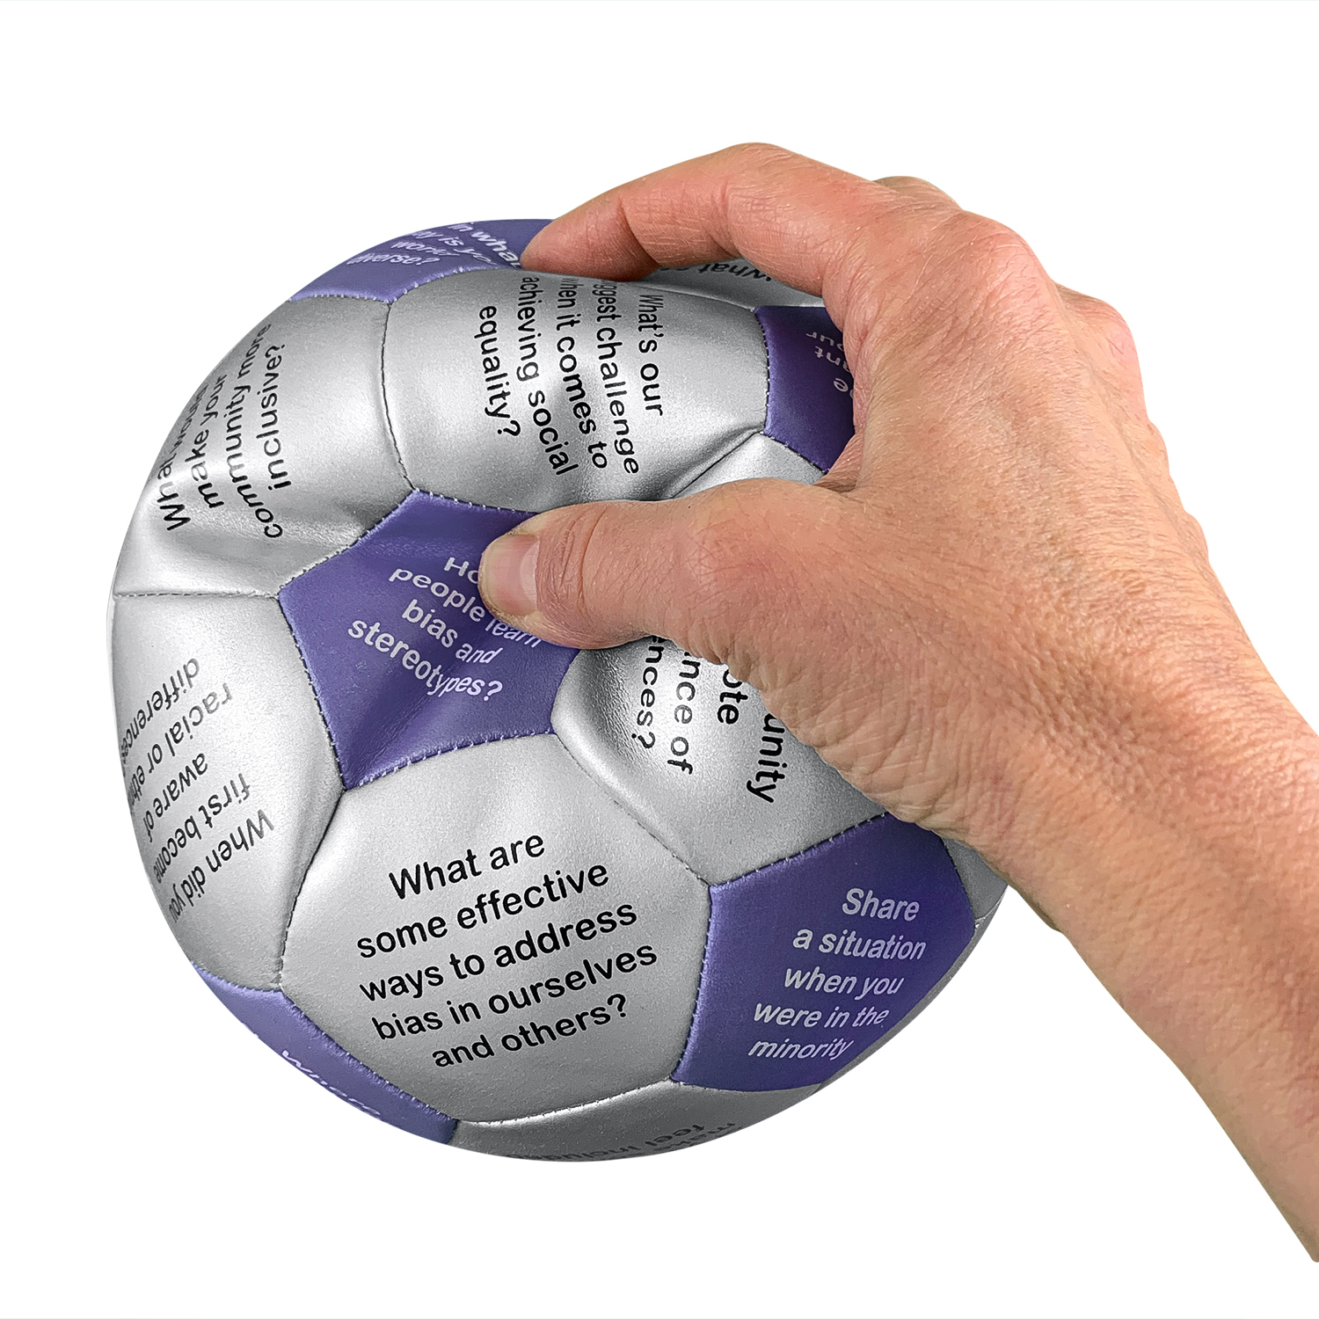
What’s next for DIVERSITY training?
Notes:
Why we’re here today.
Since we can’t talk about “diversity – ask WHY we even need diversity.

Slide 2
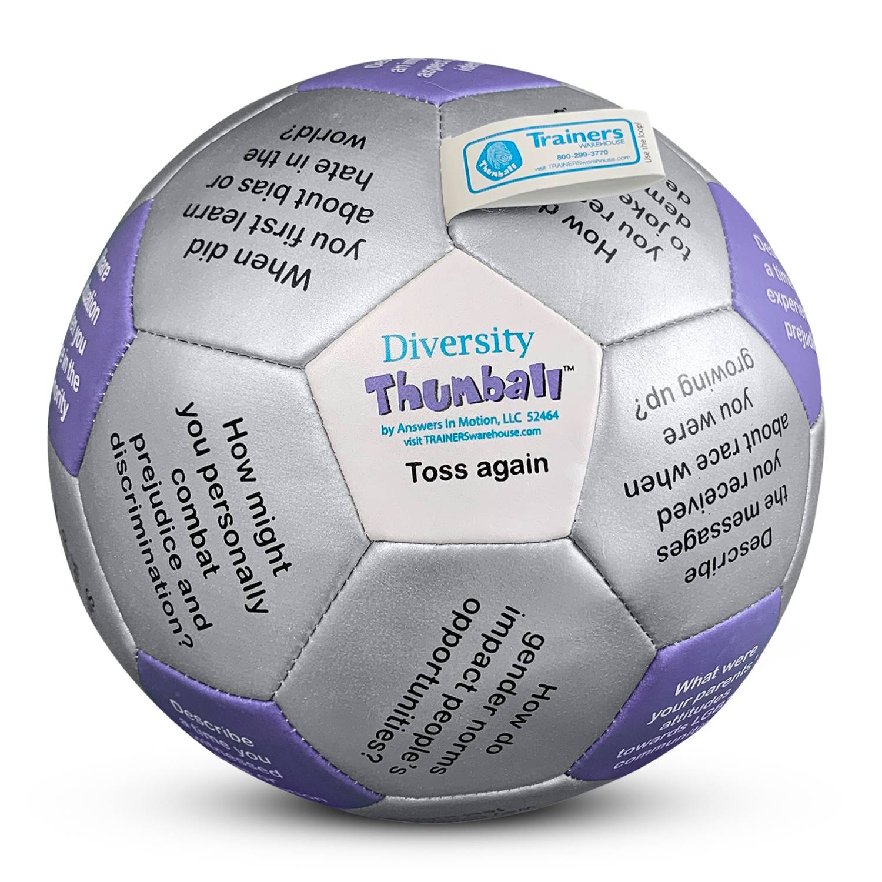
Connections Questions
What percent of your work involves diversity-related topics?
Notes:
I think it can be helpful to have a connection question at the start of the session. I don’t like this one because the answer is just a number. Perhaps better would be: What’s the course/curriculum you most fear will be “cancelled”?
5 mins

Slide 3
Connections
How ya doing?
(with respect to your DEI training – pick an image that reflects your feelings and write in the chat which you picked and why.
Notes:
I think it can be helpful to have a connection question at the start of the session. I don’t like this one because the answer is just a number. Perhaps better would be: What’s the course/curriculum you most fear will be “cancelled”?
5 mins

Slide 4

Trigger Words
Banned and Trigger Words in Federal Grant Writing in the Trump Administration 2.0
activism
activists
advocacy
advocate
barrier
barriers
biased
bias
BIPOC
Black and Latinx
community diversity
community equity
cultural differences
cultural heritage
culturally responsive
disabilities
discrimination
discriminatory
backgrounds
groups
diversified
diversify
enhancing
equal opportunity
equality
equitable
ethnicity
excluded
female
fostering
gender
hate speech
Hispanic minority
historically
implicit bias
inclusion
inclusive
increase
indigenous community
inequalities
inequities
institutional
LGBTQ
marginalize
minorities
multicultural
polarization
political
prejudice
privileges
promoting
race
racial
justice
sense of belonging
sexual preferences
social justice
sociocultural
socioeconomic
status
stereotypes
systemic
trauma
underappreciated
underrepresented
underserved
victim
women
NOTE: The colors are my attempt to organize this list into words that I might associate with DEI vs others, which honestly just surprised me.
~ Susan Landay
Notes:
SHARE BY US: This list is horrifying, but helpful to see for those who haven’t.
Maybe just a moment of silence as people take it in (and mourn a little)
Circle the words (or check mark) that will affect your training.

Slide 5
NEW Words?
Authenticity
Civility
Commonality
Comfort
Compassion
Cultural Sensitivity
Dignity
Emotional Intelligence
Empathy
Ethics
Honesty
Individuality
Integrity
Knowledge
Resilience
Power
Respect
Safety
Stigma
Threat
Transparency
Trust
Unity
D. E. I.?
Deliver
Devoted
Delightful
Diplomacy
Driving
Dynamic
Determination
Dignity
Enterprise
Exceptional
Expression
Enrichment
Engagement
Empowerment
Energetic
Enabling
Inclusivity
Inspiration
Ingenuity
Impact
Individuality
Innovation
Insight
Integrity
Delivering Enterprise Inclusivity Delivering Enterprise Inspiration Devoted to Exceptional Ingenuity Delightful Expressions of Inclusivity Diplomacy. Enrichment. Impact. Driving. Engaging. Insightful. Dynamically Empowering Individuality Delivering & Enabling Innovation Driving Enterprise Insight
Notes:
Might it be helpful to make a list of the new words people are using or considering?
Are there others we should add to this?
[Give time to process and reply!]

Slide 6
DEMINGS 5 WHYs
Why do we need to value diversity?
Why is it so polarizing at this time?
Why is devaluing diversity undesirable?
Why?
Why?
The Roots of valuing diversity
In other words, if we went one concept "before" the need to value diversity, what might be there?“ For instance: if we didn't stigmatize each other, we wouldn't need to value diversity. Stigma* is judging someone else defective because of differences in origin, character or physiology. (This is the first of Deming's five whys on this for me...)
*Stigma – comes from Irving Goffman – Stigma: the Management of Spoiled Identity
Notes:
Elizabeth facilitates a WHY inquiry: Via chat and/or verbal inputs
By asking this question we hope to get to how we can reframe the

Slide 7
DISCUSSION BREAKOUTS (to find new solutions)
Assuming that “judging others” is the root cause for needing diversity training, how might this inform changes to current efforts?
Describe the strategies you’re currently trying right now. What’s working? What are you learning?
What sorts of barriers are you facing (or do you anticipate) as you adjust your content?
Notes:
Depending on how many people join the conversation, we could either break into groups for this, or we could just set an order and priority for the questions. Or, ask participants which they want to start with. (Approximately 5-9 per group)
10 mins in small groups to discuss assigned question (feel free to switch if your group wants)
Be prepared to share what your group has learned… (feel free to take notes in Chat so you can share later–or any other means)

Slide 8
Big Group Questions…
What did you learn in your breakout groups?
What support can we offer or request from each other?
What might you rename training & learning about sensitive topics?
Notes:
Depending on how many people join the conversation, we could either break into groups for this, or we could just set an order and priority for the questions. Or, ask participants which they want to start with.

Slide 9
Thumballs for HERE & NOW…
Common Ground – see what we have in common
Emotional Intelligence – build self-awareness, empathy, social skills
Managing Change – discuss topics that help you move onward
Building Trust – build bridges and interpersonal trust
Building Resilience – foster patience, acceptance, and kindness
Stress Management – examine sources and remedies for stress
Workplace Ethics – talk about challenges of doing what’s “right”
“Dignity” a.k.a. Diversity – explore what shapes our perspectives
Notes:
Understanding that part of cultural sensitivity training is getting people talking, I’d like to offer these as resources. We do have Diversity and DEI question sets as well, but these may create triggers for participants or management. So these are some alternatives.

Slide 10
LinkedIN DATA supporting DEI
60% of respondents in a LinkedIn study said that diversity within their sales team has contributed to their teams’ success.
Employers that posted about diversity saw 26% more applications from women than employers who posted less.
Companies with a DEI team were 22% more likely to be seen as “an industry-leading company with high-caliber talent” and 12% more likely to be seen as an “inclusive workplace for people of diverse backgrounds.” LinkedIn study
76% of employees and job seekers said diversity was important when considering job offers.
60% of employees want to hear business leaders speak up on diversity issues.
80% of survey respondents said they want to work for a company that values DEI issues.
Posts on LinkedIn about diversity received 1.9x the engagement of other posts in 2020.
LinkedIn

Slide 11
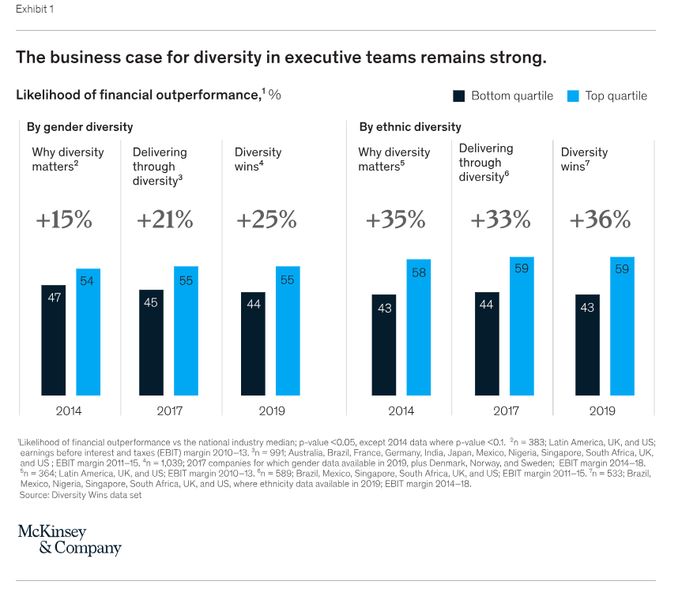
McKinsey DATA supporting DEI
McKinsey Study
Our 2019 analysis finds that companies in the top quartile for gender diversity on executive teams were 25 percent more likely to have above-average profitability than companies in the fourth quartile—up from 21 percent in 2017 and 15 percent in 2014 (Exhibit 1).

Slide 12
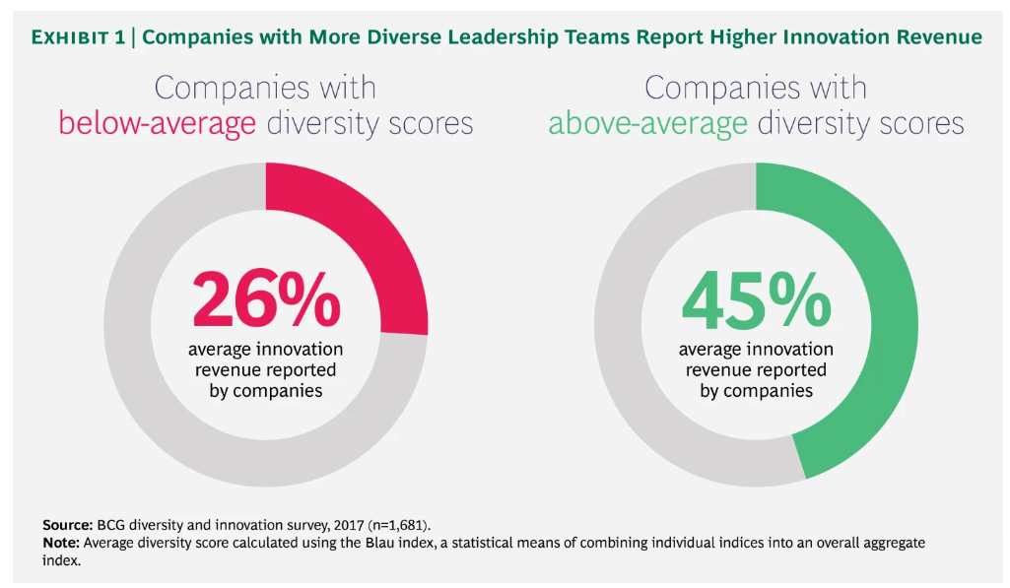
BCG DATA supporting DEI
Boston Consulting Group
Companies that reported above-average diversity on their management teams also reported innovation revenue that was 19 percentage points higher than that of companies with below-average leadership diversity—45% of total revenue versus just 26%. (See Exhibit 1.)

Slide 13
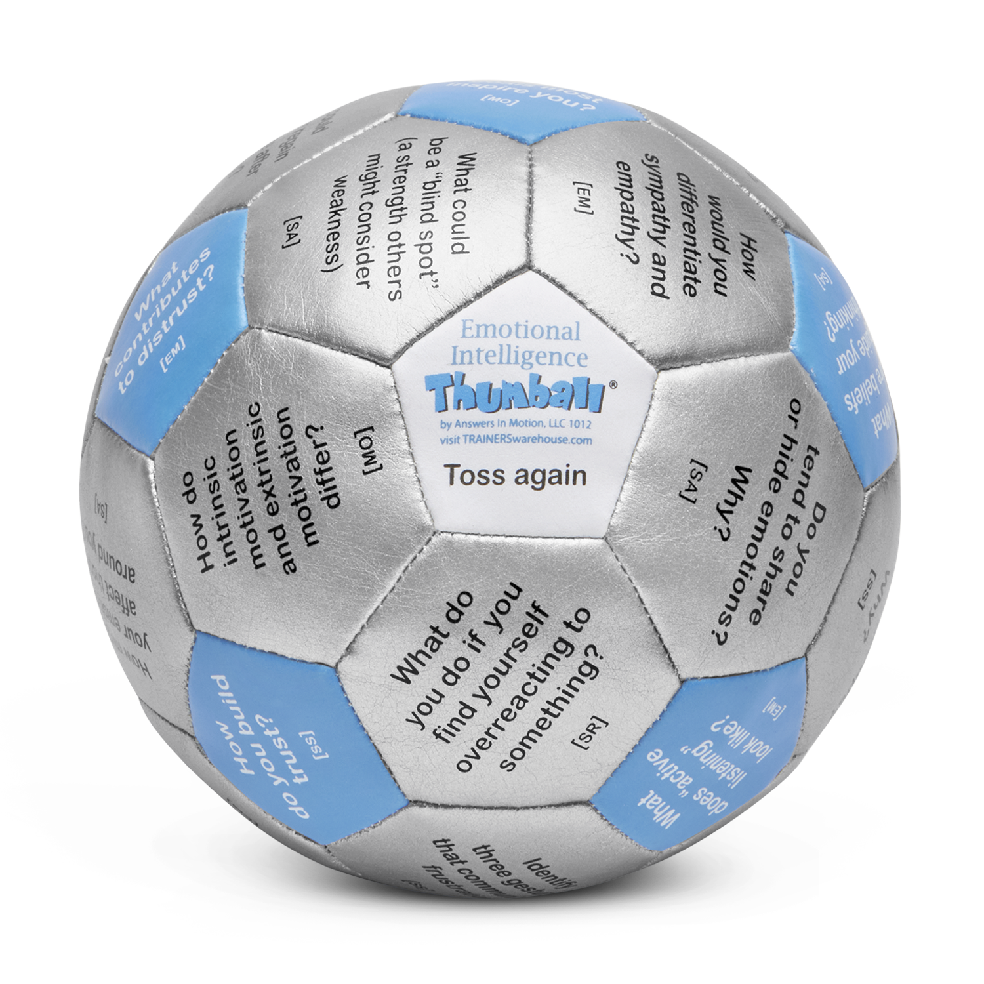
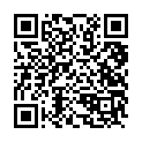
Emotional Intelligence Thumball

